Slide 1
Capstone Project- (CSE7101)
Final Review Presentation
Non-Invasive Skin disease Detection Using Hyper Spectral Imaging
By
CSD_3
Under the supervision of
Dr.Madhusudhan M V
NAME | ROLL
AKHIL SANJAY | 20221CSD0067
S ARSHIYA | 20221CSD0129
JILPHA SUSMITH | 20221CSD0066

Slide 2
Project Objective
The primary objective of this project is to develop a non-invasive diagnostic system that utilizes hyperspectral imaging (HSI) technology for detecting and classifying skin diseases. Conventional diagnostic procedures for skin conditions often involve invasive biopsies, which can be uncomfortable, time-consuming, and sometimes unnecessary. This project aims to leverage HSI’s capability to capture detailed spectral information from skin tissue, enabling early and accurate detection without physical intervention. The system will be designed to identify spectral signatures specific to different skin diseases, including malignant melanoma, benign nevi, and inflammatory conditions.

Slide 3
Project Objective
Implementation of Advanced Machine Learning Models for Analysis
To accurately analyze the vast and complex hyperspectral data, the project will implement advanced machine learning techniques, including deep learning architectures and traditional classifiers. These models will be trained to extract relevant features from the hyperspectral bands, perform lesion segmentation, and classify the disease types based on their unique spectral and spatial characteristics. The objective includes optimizing algorithms to improve classification accuracy and to handle challenges such as spectral noise and overlapping features between different skin conditions.

Slide 4
Background
Skin diseases, including malignancies like melanoma, represent a major public health concern worldwide. Early and accurate diagnosis is critical to improving treatment outcomes and survival rates, particularly for skin cancer. Traditional diagnostic approaches rely heavily on visual examination by dermatologists and invasive biopsy procedures for histopathological confirmation. However, these methods have limitations: visual inspection can be subjective and biopsy is invasive, costly, and time-consuming.

Slide 5
Background
Non-invasive imaging techniques have emerged as promising alternatives to traditional methods. Among these, hyperspectral imaging (HSI) stands out by capturing detailed spectral information across a wide range of wavelengths from the skin surface. This multispectral data contains rich biochemical and morphological information, allowing differentiation of tissue types and disease states beyond what is visible to the naked eye or standard RGB cameras.

Slide 6
Related Work
Research in non-invasive skin disease diagnosis using hyperspectral imaging has expanded over the last decade, demonstrating promising results in clinical diagnostics.
Several studies have shown that hyperspectral imaging can differentiate between benign and malignant skin lesions by analyzing their distinct spectral signatures. For example, spectral differences in melanin, hemoglobin, and water content have been exploited to identify melanoma with improved accuracy over traditional methods.

Slide 7
Related Work
Research in non-invasive skin disease diagnosis using hyperspectral imaging has expanded over the last decade, demonstrating promising results in clinical diagnostics.
Several studies have shown that hyperspectral imaging can differentiate between benign and malignant skin lesions by analyzing their distinct spectral signatures. For example, spectral differences in melanin, hemoglobin, and water content have been exploited to identify melanoma with improved accuracy over traditional methods.

Slide 8
Problem Statement
Skin diseases, including cancerous conditions like melanoma, require early and accurate diagnosis to improve treatment outcomes. Current methods rely on visual examination and invasive biopsies, which can be subjective, uncomfortable, and costly. There is a need for non-invasive, rapid, and objective diagnostic tools. Hyperspectral imaging offers detailed spectral data that can help differentiate skin diseases without physical intervention. However, analyzing this complex data accurately remains challenging due to variability in skin types and lesion characteristics. This project aims to develop a non-invasive skin disease detection system using hyperspectral imaging and machine learning to provide reliable, fast, and objective diagnosis, reducing the dependency on biopsies.

Slide 9
Proposed Methodology
1. Dataset Selection and Understanding
Identify and acquire publicly available or previously collected hyperspectral skin imaging datasets that include labeled examples of various skin diseases and healthy skin.
Study dataset characteristics such as spectral range, spatial resolution, types of skin conditions included, and labeling quality to ensure suitability for your objectives

Slide 10
Proposed Methodology
2. Data Preprocessing
Clean the dataset by removing corrupted or incomplete samples.
Apply spectral calibration and normalization to standardize the data across images and reduce variability due to acquisition conditions.
Perform noise reduction to enhance spectral signal quality.
Use dimensionality reduction techniques such as Principal Component Analysis (PCA) to reduce computational complexity while retaining salient spectral features.

Slide 11
Proposed Methodology
3.Feature Extraction
Extract spectral and spatial features from the segmented lesions.
Features could include spectral signatures, texture descriptors, and morphological parameters, which reflect the biochemical and structural properties of skin lesions.
4. Classification Model Training and Optimization
Train machine learning models (e.g., Support Vector Machines, Random Forests, or deep neural networks) on the extracted features with labeled data.
Use techniques such as cross-validation and hyperparameter tuning to optimize model performance and prevent overfitting.
Compare different classifiers to select the most effective model for skin disease detection

Slide 12
Proposed Methodology
5. Performance Evaluation and Validation
Evaluate the trained model on unseen test data from the dataset.
Calculate performance metrics such as accuracy, sensitivity, specificity, precision, and recall.
Analyze results to identify strengths and limitations and consider possible improvements.

Slide 13
Proposed Methodology
7. Documentation and Reporting
Document all preprocessing steps, model architectures, training parameters, and evaluation results rigorously for reproducibility.
Prepare visualization of findings including classification results and performance metrics

Slide 14
Innovation and Novel Contributions
This project uniquely combines hyperspectral imaging with advanced machine learning to enable non-invasive, rapid, and highly accurate detection of skin diseases. By analyzing detailed spectral information beyond visible light, it improves early diagnosis and differentiation of malignant and benign lesions. The use of attention-based segmentation models further enhances lesion localization. Overall, this approach offers a user-friendly, objective diagnostic tool that can reduce reliance on invasive biopsies and has strong potential for clinical adoption.

Slide 15
Results and Discussion
The 3D U-Net model for melanoma staging was evaluated using hyperspectral imaging (HSI) data cubes that record both spatial and spectral details. The model exhibited diminishing loss and rising validation accuracy as it converged smoothly without overfitting. With efficient capture of spectral-spatial correlations, volumetric convolutions, enhanced stage prediction, and lesion segmentation. At a 97.96% F1-score, it held high sensitivity and specificity while accurately classifying all four melanoma stages with minimal false positives. This work shows 3D U-Net architectures significantly improve non-invasive, automated melanoma staging with hyperspectral imaging (HSI) to 97.94% accuracy. Through capturing spatial and spectral tissue characteristics, the model successfully discriminates stages of melanoma. Deep contextual learning is made possible by its 3D convolutions, as opposed to 2D approaches.

Slide 16
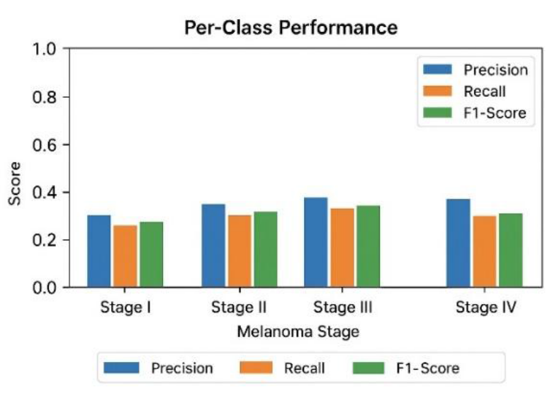
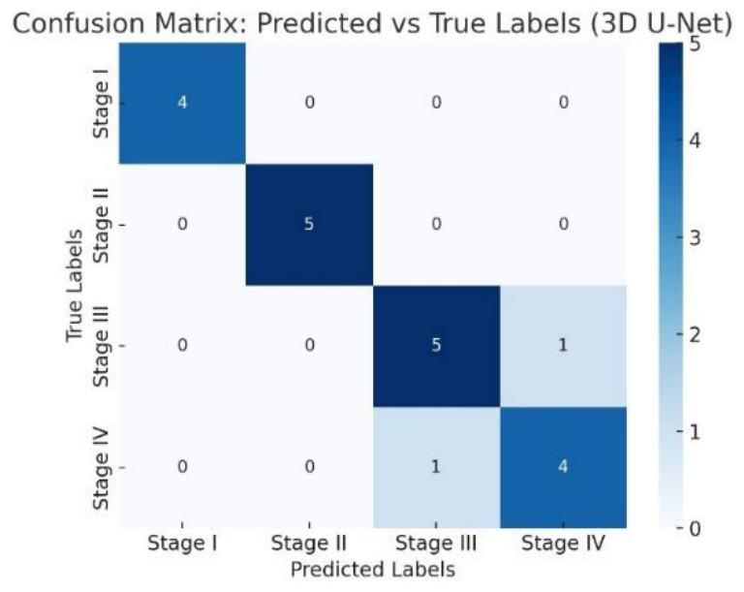
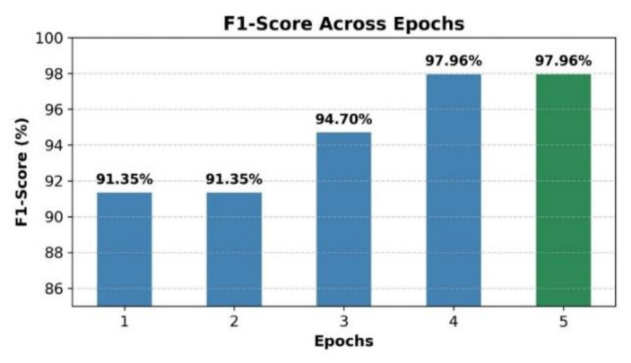
Results

